Slide 1
Wheat Prices Forecasting
Task by IDSC
Made by Ahmed Tarek
Date 16/01/2021

Slide 2
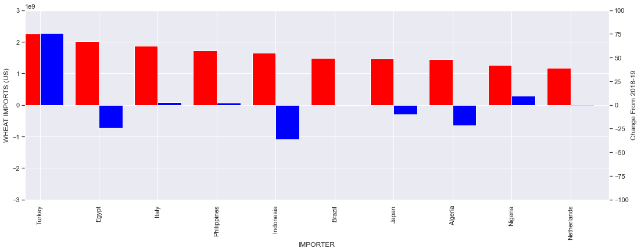
Problem Understanding | Global Imports
According to "World's Top Exports" Egypt is ranked 2 in the top wheat importing countries in 2019.
Nevertheless, it is the 3rd largest decline in wheat imports with 23.8% decrease.
source of data: http://www.worldstopexports.com/wheat-imports-by-country/

Slide 3
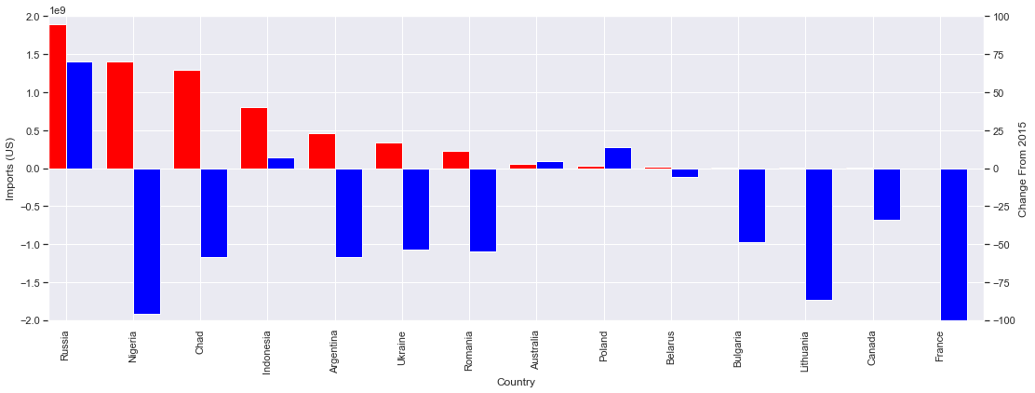
Problem Understanding | Egypt’s Imports
Egypt’s most exporting country for wheat is Russia in 2018 with significant increase from previous years.
Top countries after Russia seems to have a significant reduced changes from previous years.
source of data: http://www.worldstopexports.com/wheat-imports-by-country/

Slide 4
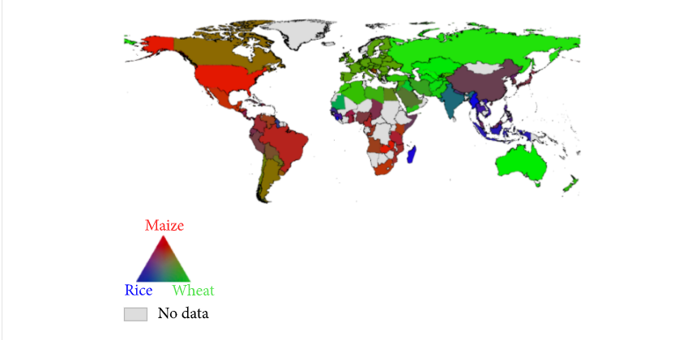
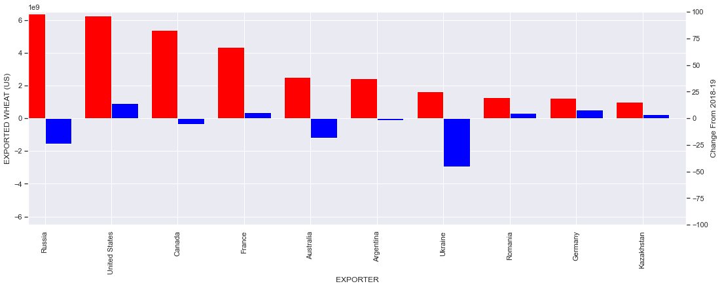
Problem Understanding | Wheat Market
Wheat prices is affected by climate, yield, oil prices, lagged prices and imports¹.
wheat and rice are the main commodities in Egypt.
Russia is the top exporter of wheat in 2019 but with a significant reduction from previous year. USA is showing a significant growth from previous year
source: An Overview of Global Wheat Market Fundamentals in an Era of Climate Concerns, International Journal of Agronomy, https://www.hindawi.com/journals/ija/2017/3931897/
source of data: http://www.worldstopexports.com/wheat-imports-by-country/

Slide 5
Project Flow
Spot future forecast
Spot Preprocessing
Spot preprocessed
Spot Modelling
Spot Long
Spot model evaluation
Assessmentxlsx
Data Wrangling
EDA
future Long
Future future forecast
Future Preprocessing
future preprocessed
Future Modelling
Future model evaluation
input
stage
output

Slide 6
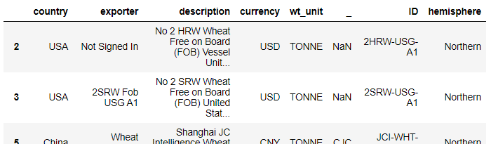
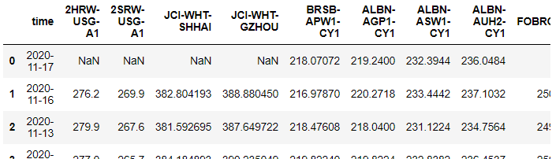
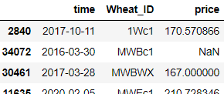
Project Flow | Data Wrangling
For both Spot and Future:
Automated function is made to :
Metadata is extracted from excel columns header.
Metadata is augmented with external information like hemisphere.
Prices data is extracted from excel file using automated flow
Data is transferred into long format as it is more convenient for downstream steps.

Slide 7
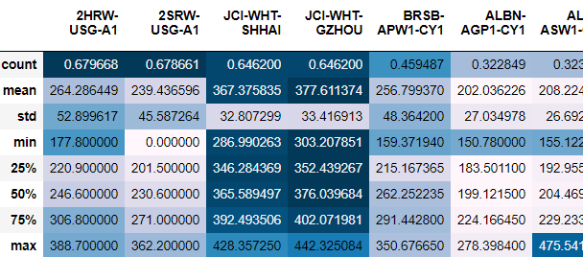
Project Flow| EDA
From Initial Statics:
Some time series is showing a large null percentage
Median is very close to mean in high number of samples data, which may infer normal distribution
Prices are showing a consistent medians per country. However, it seems that wheat type has a lower contribution.
Some countries also seem to show higher variations that others in prices.

Slide 8
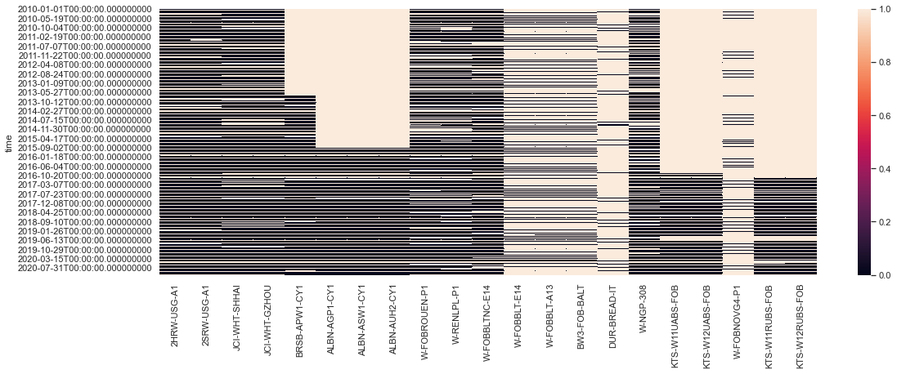
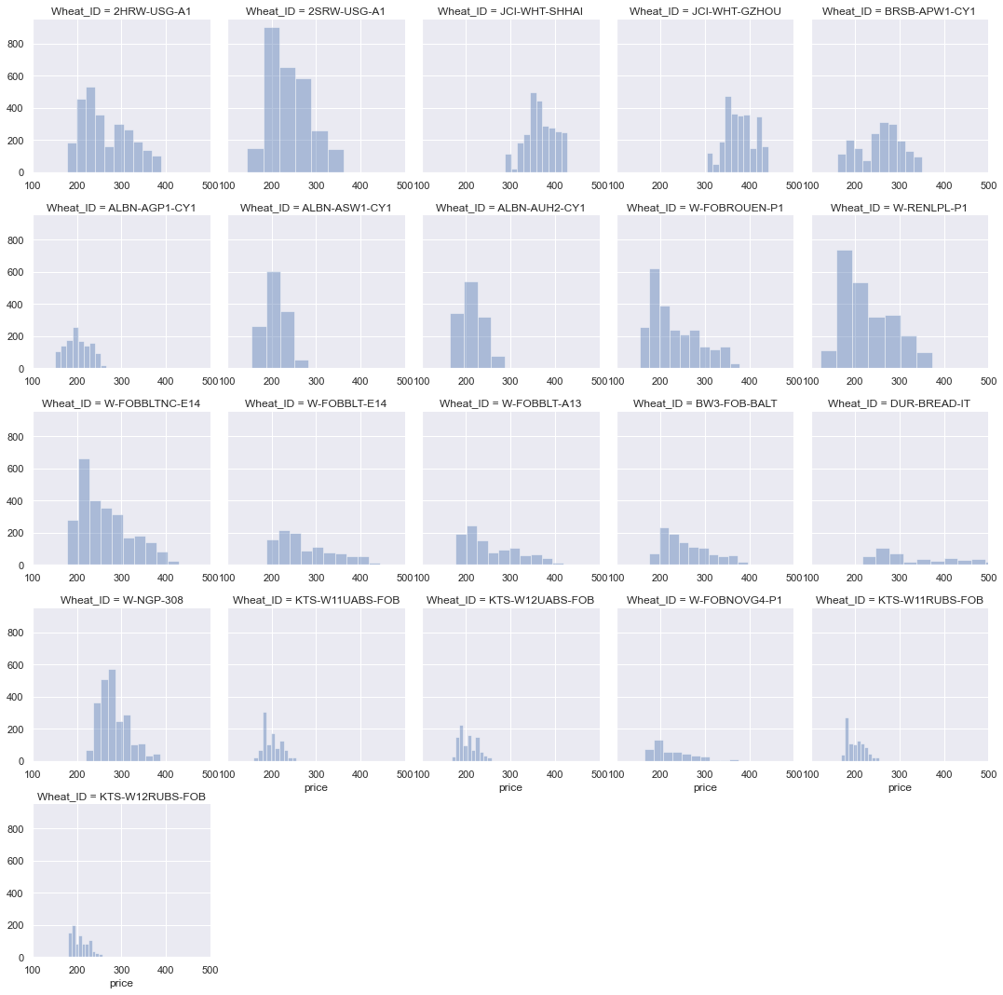
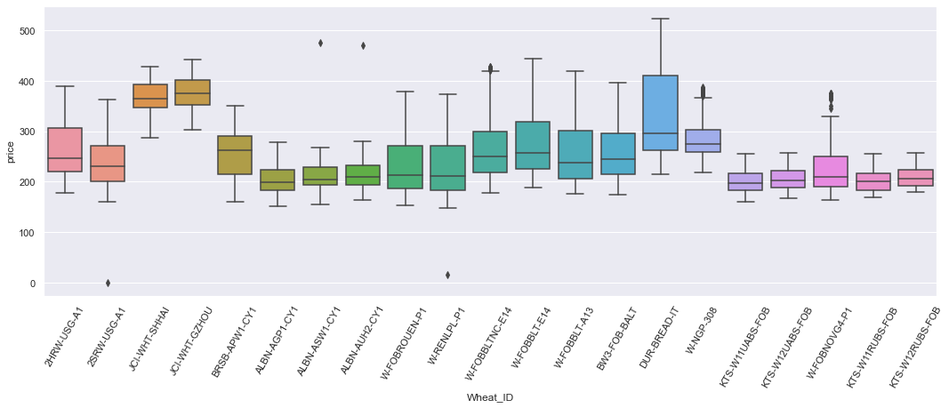
Project Flow| EDA
Missing data:
Nulls have almost similar distributions for wheat IDs coming from same country
Some time series data have their nulls clustered in old dates
Data univariate distribution:
Right skewed , which expected from monetary data
Kurtotic
Outliers exist in 2SRW, ALBN, W-REN

Slide 9
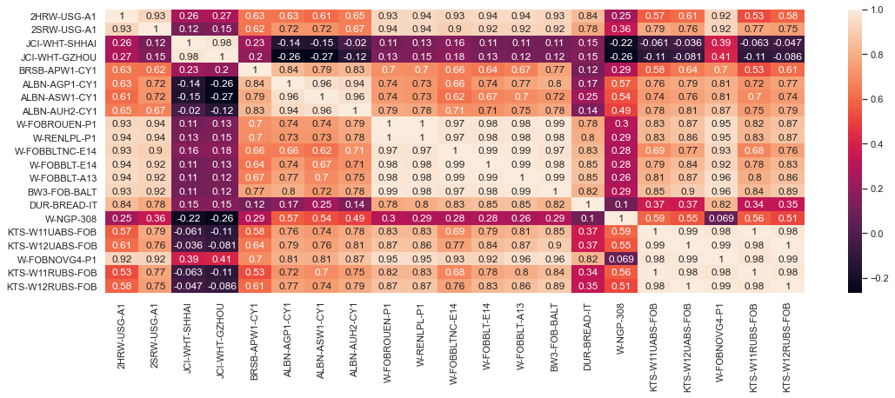
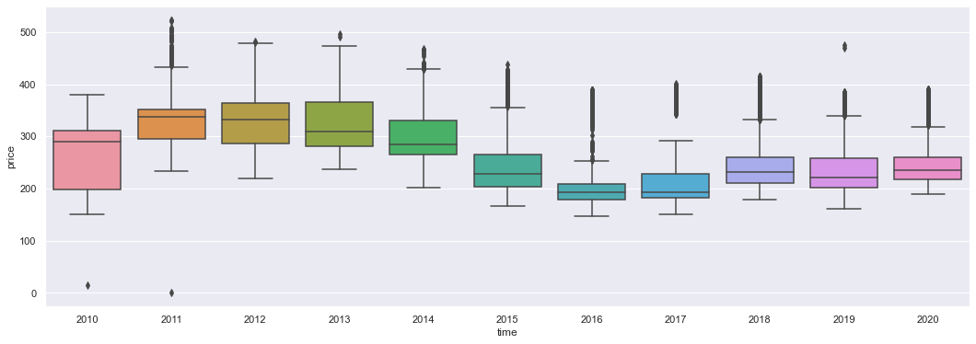
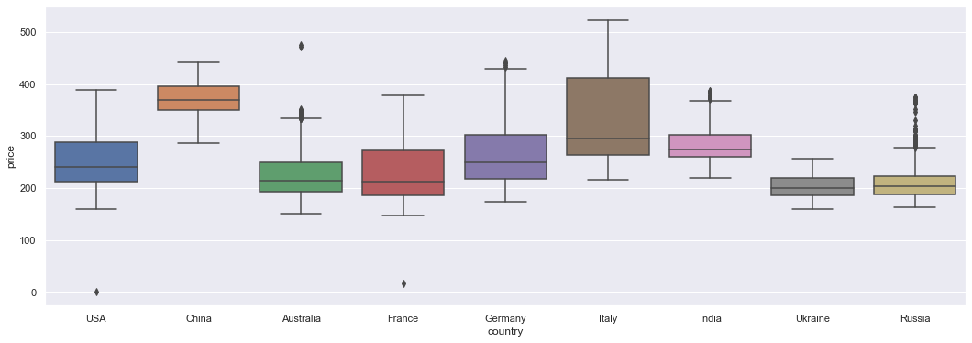
Project Flow| EDA
Data bivariate distribution:
Generally, wheat prices seem to be correlated with each other.
the USG Wheat is having a very high to moderate linear correlation with most of other wheats except (Chinese (JCI) and Indian (NGP)).
Chinese & Indian wheat are showing a very weak correlation with all other markets
Hypothesis Testing:
Chinese wheat is showing prices significantly higher than normal.
Whet prices were reducing till 2016, where they stabilized or slightly increased.
Both country and month are showing significant effect on wheat prices.

Slide 10
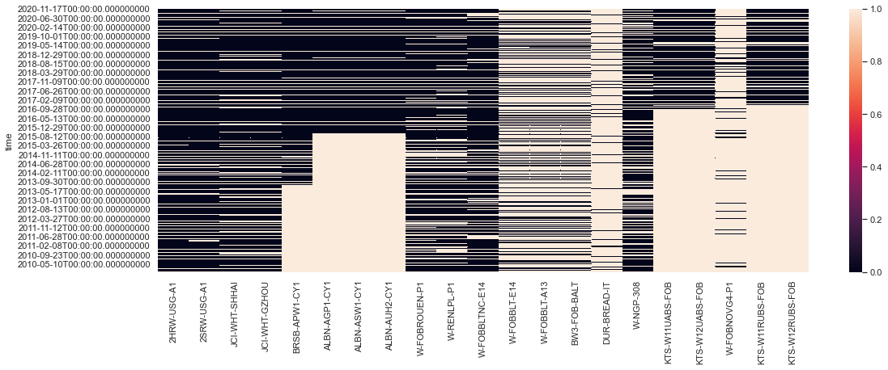
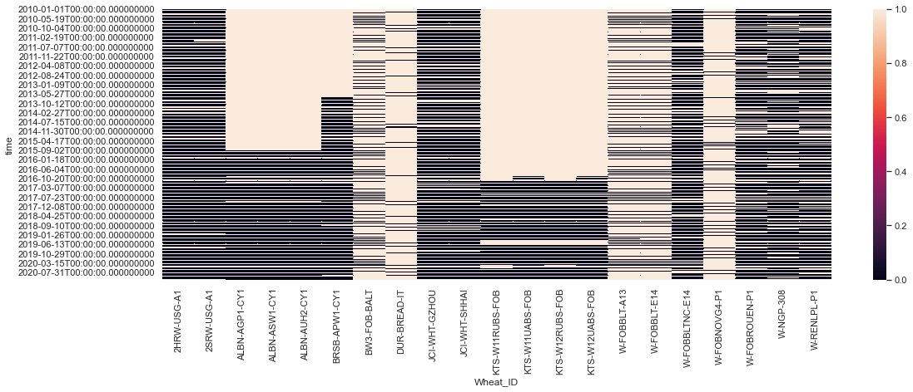
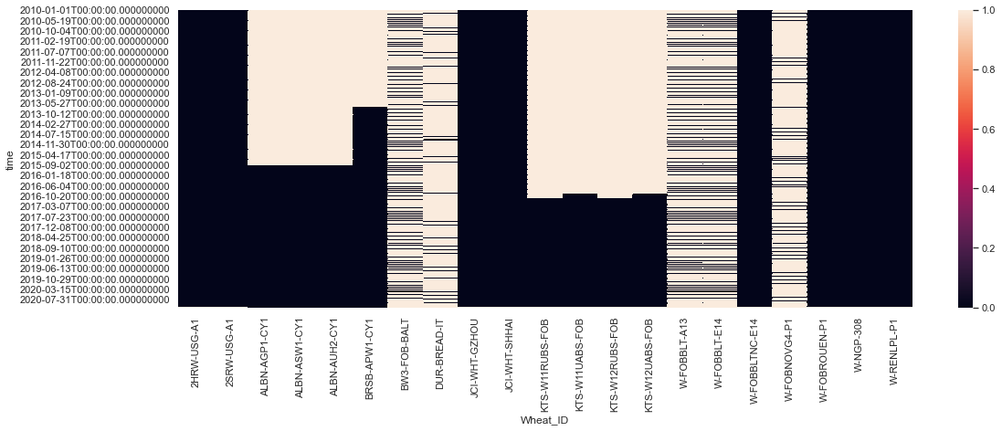
Project Flow| Preprocessing
Removed outliers using a more tolerant threshold after visualizing to prevent losing any real data.
Preprocessed to add proper time step and that all steps values exist
Filled Nulls accordingly:
low nulls, with linear interpolation using time
time clustered high nulls, only the existing time will be used and filled, while old not existing times will be dropped
Non clustered high nulls, will be dropped for now from analysis

Slide 11
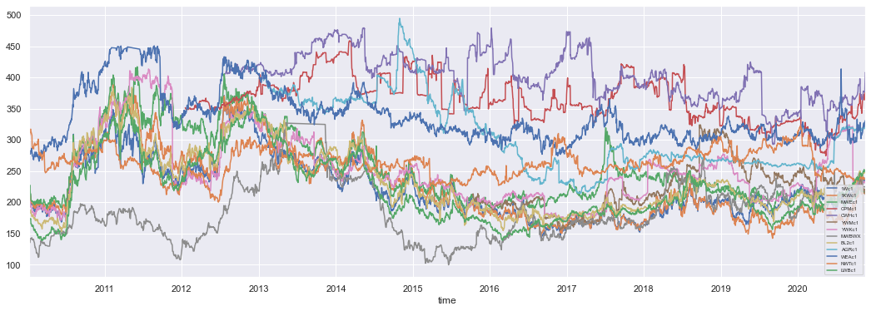
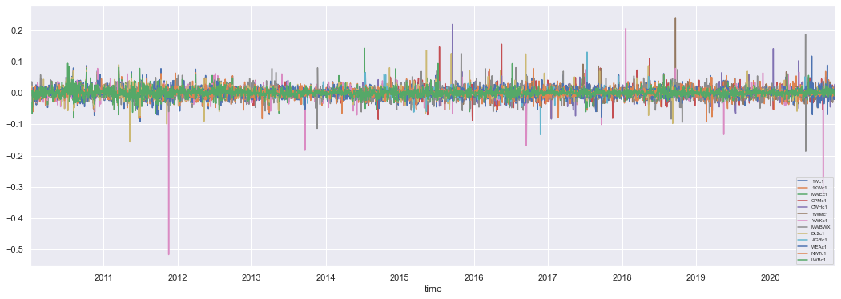
Project Flow| Preprocessing
Throw visualization, it can be seen that TS are mostly non-stationary.
low P-Value in,while in KPSS high values concludes that TS are not stationary from both tests.
log with the lag diff transform is made to stationaries.
TS have followed more stationary pattern with very confidence.

Slide 12
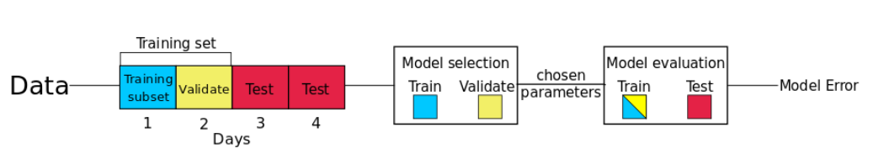
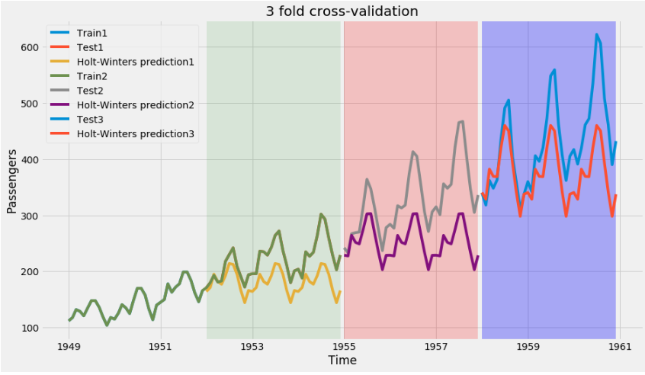
Project Flow| Modelling | Evaluation
In-sample fit such as R2 is even more frowned upon as a measure of model quality in forecasting than in other statistical subdisciplines²
Used Validation method is taking a last temporal portion from each TS as a test data
Metric used is RMSE (note that I have added R2, for interest, but will not be used)

Slide 13
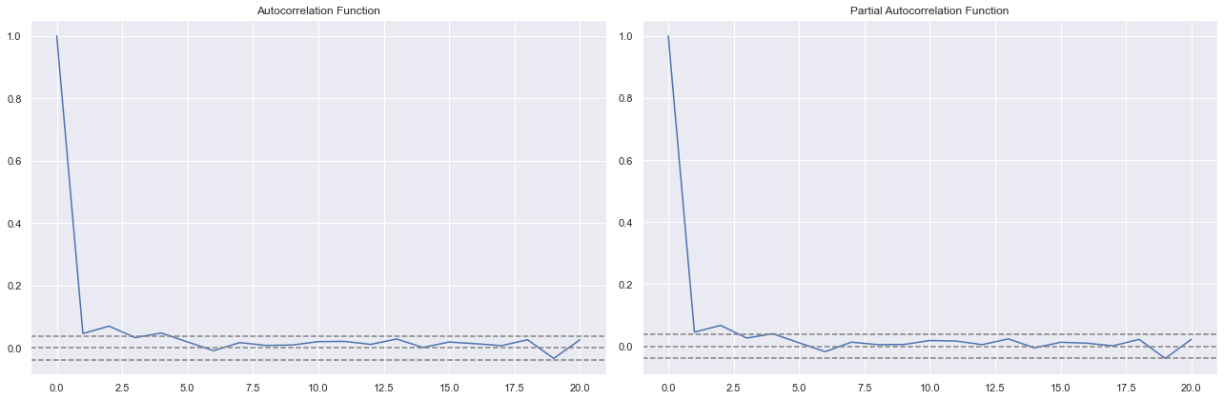
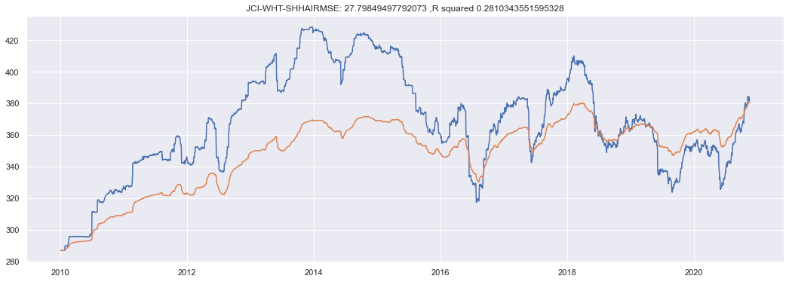
Project Flow| Modelling | ARIMA
ARIMA is showing variant performance depending on the Wheat TS.
ARIMA would be difficult to automate as the ACF and PACF need to be checked manually
No searching for parameters (p,q,d,P, Q,D)is offered as out of the box

Slide 14
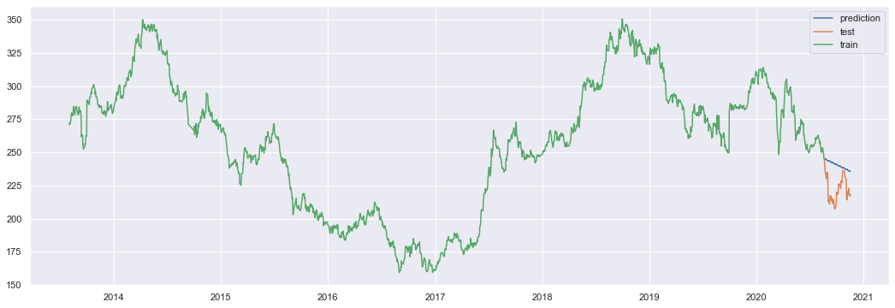
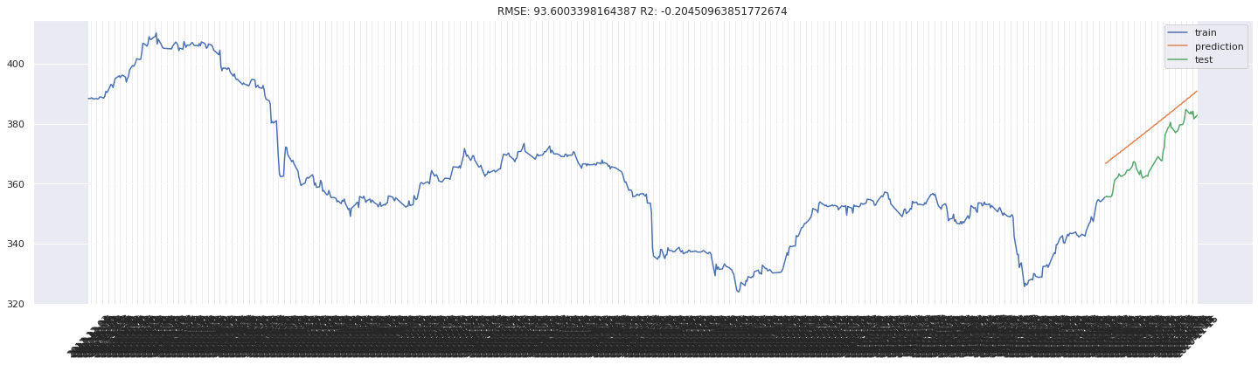
Project Flow| Modelling | AutoARIMA
AutoARIMA allowed the automated modelling of multible TS
AutoARIMA consumes avery high resources, so this block was excuted on google CoLab
Similar to ARIMA, some TS shows better performance than others
ALBN-AGP1-CY1
JCI-WHT-SHHAI

Slide 15
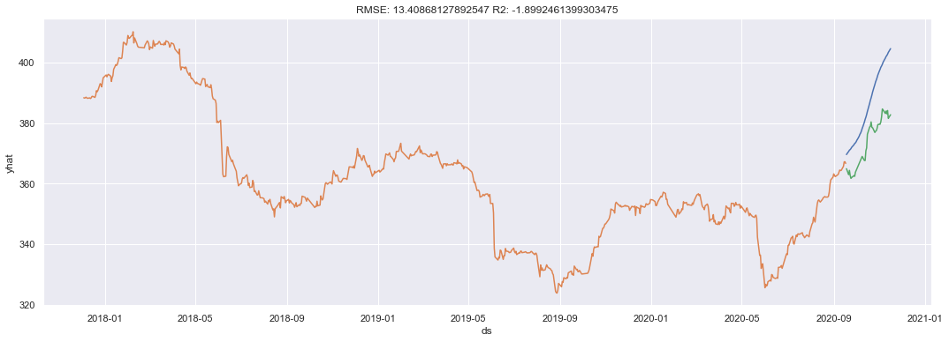
Project Flow| Modelling | FBProphet
FBprophet is the state-of-the-art automated time series forecasting model
Forecasting performance on all endpoints is increased x10
Seasonality as well as stationarity handling which required significant work on Arima took much lower time in FBprophet
JCI-WHT-SHHAI

Slide 16
Project Flow| Modelling | Results
AARIMA SPOT
FBProphet SPOT
FBProphet FUTURE

Slide 17
Future Work
Work on Deep Learning Model like CNN (Was not used initially as DL tend to perform lower on smaller data).
More hyperparameter tunning and different preprocessing steps to enhance the model.
More EDA and link to external sources like (Temperature, Oil prices, Yield and Economic status).
Try multivariate predictions using the above-mentioned variables to predict prices.

Slide 18
References
1. De Luca, Anna I., An Overview of Global Wheat Market Fundamentals in an Era of Climate Concerns, International Journal of Agronomy, 2017, https://doi.org/10.1155/2017/3931897
2. Forecasting Principles and Practices, Evaluating forecast accuracy, https://otexts.com/fpp2/accuracy.html

